Slide 1

GRAPH THEORY AND ITS APPLICATIONS
Dr. Arti Arya
Department of Computer Science & Engineering

Slide 2
GRAPH THEORY AND ITS APPLICATIONS
Chromatic Partition
Dr. Arti Arya
Department of Computer Science & Engineering

Slide 3
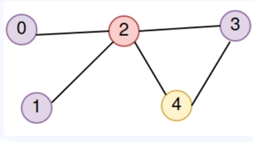
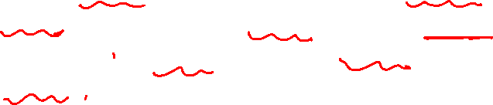
Graph Theory and its Applications
Graph Coloring
Chromatic Partitioning
Proper coloring of graph G induces a partitioning of vertices into different subsets.
No two vertices in any of these subsets are adjacent.
A set of vertices in a graph is said to be an independent set of vertices if no two vertices in the set are adjacent.
A maximal independent set or maximal internally stable set is an independent set to which no other vertex can be added without destroying its independence property.
Graph partitioning:
A:{0, 1, 3}
B:{2}
C:{4}

Slide 4
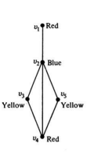
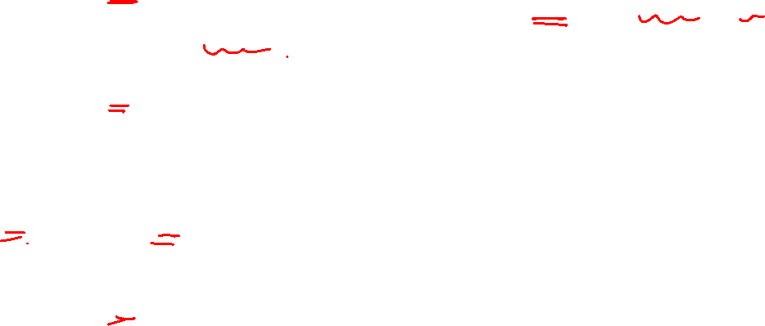
Graph Theory and its Applications Graph Coloring
The coloring produces the partitioning {v1 , v4}, {v2}, and {v3 , v5}.

Slide 5
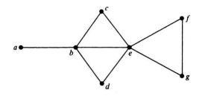
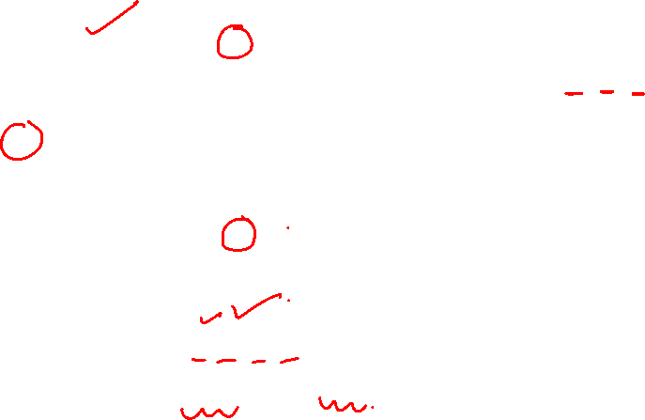
{a, c, d} is an independent set
The set {a, c, d, f} is a maximal independent set.
The set {b, f} and {b,g} is another maximal independent set.

Slide 6
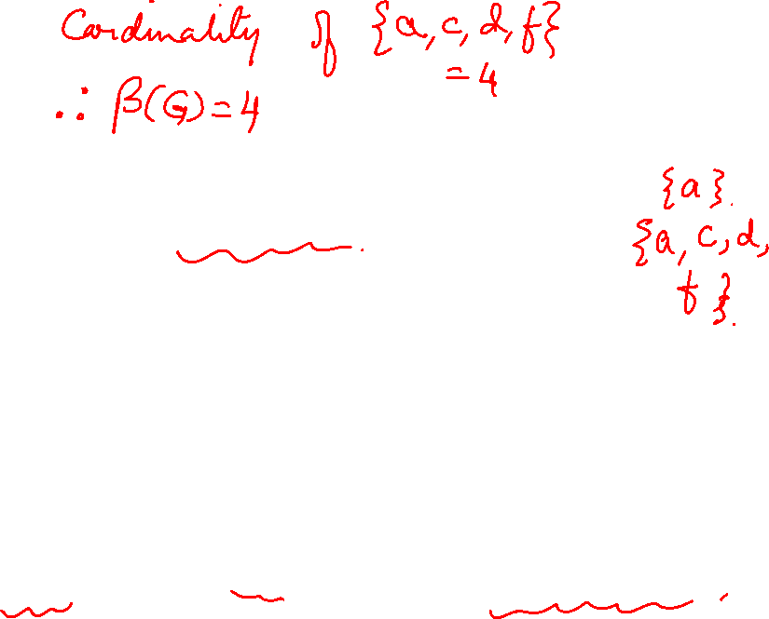
Graph Theory and its Applications Graph Coloring
Chromatic Partitioning
The # of vertices in the largest independent set ( cardinality of maximal independent set) of a graph G is called
the independence number β(G) or coefficient of internal stability.
Finding a Maximal Independent Set:
Start with any vertex.
Add more vertices to the set selecting at each stage a vertex that is not adjacent to any of those already selected.
This Set not necessarily a maximal independent set with largest number of vertices.

Slide 7
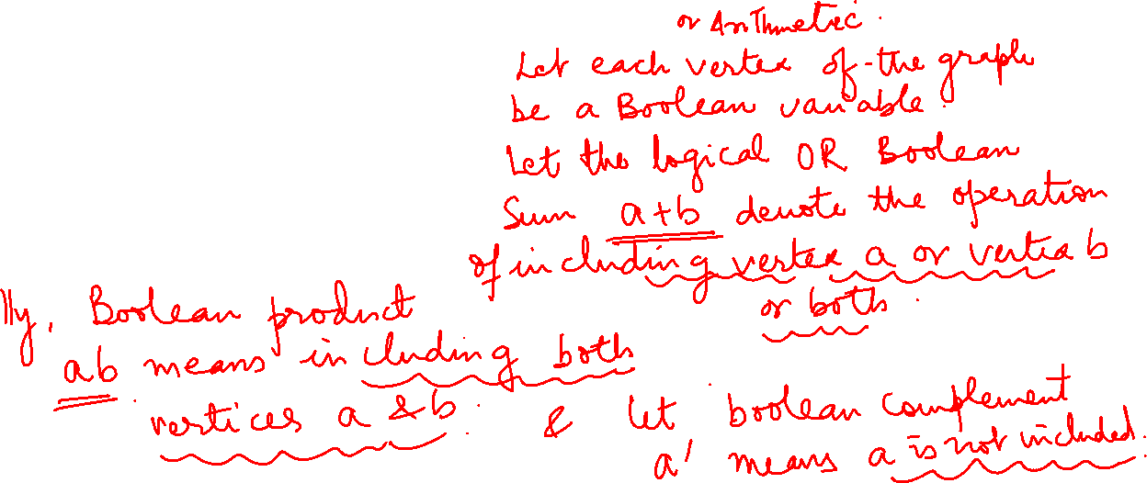
Graph Theory and its Applications Graph Coloring
Finding All Maximal Independent Sets( Using Boolean Algebra):

Slide 8
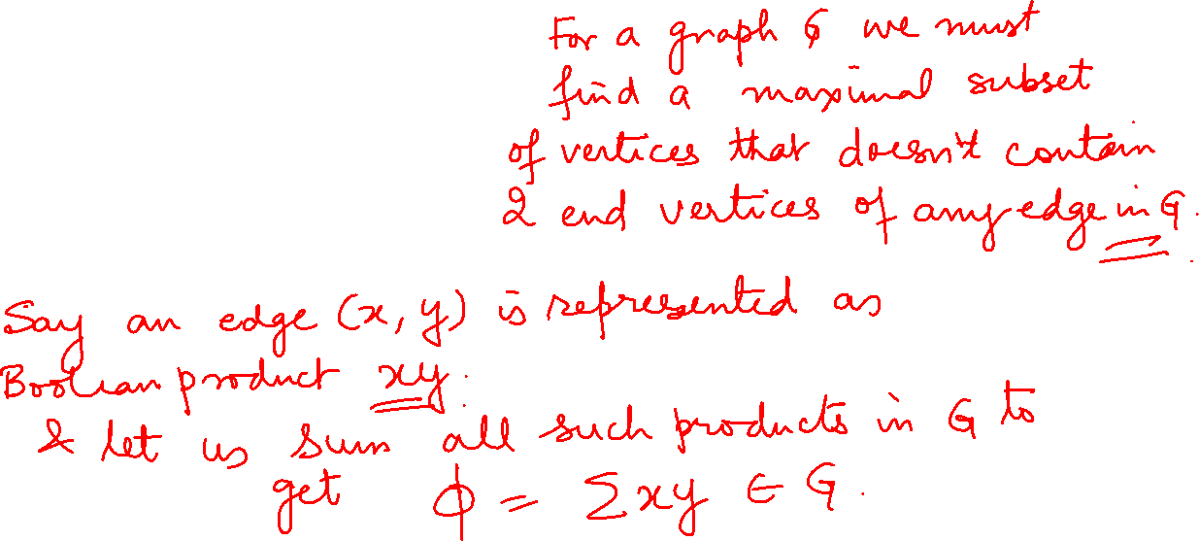
Graph Theory and its Applications Graph Coloring
Finding All Maximal Independent Sets:

Slide 9
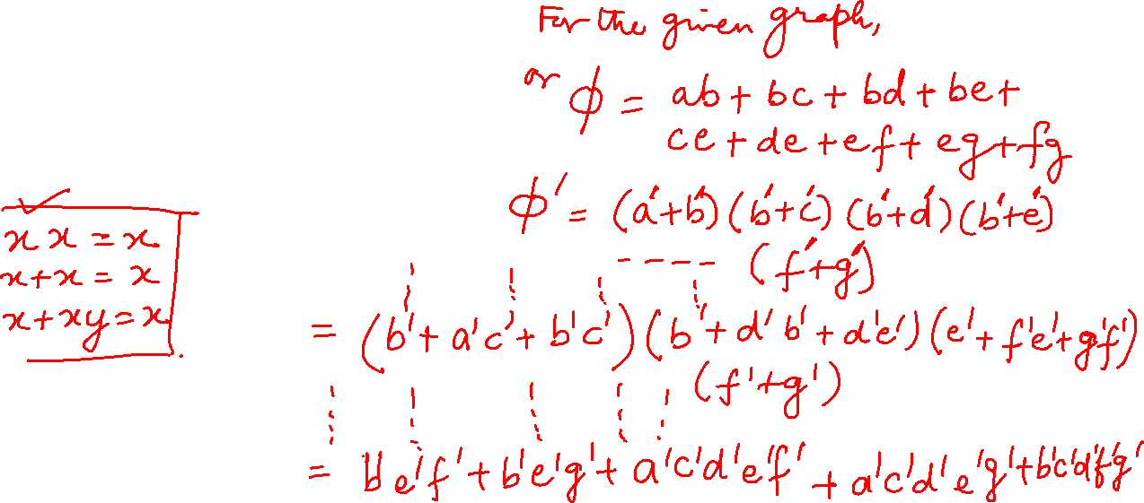
Graph Theory and its Applications Graph Coloring
Finding All Maximal Independent Sets:

Slide 10
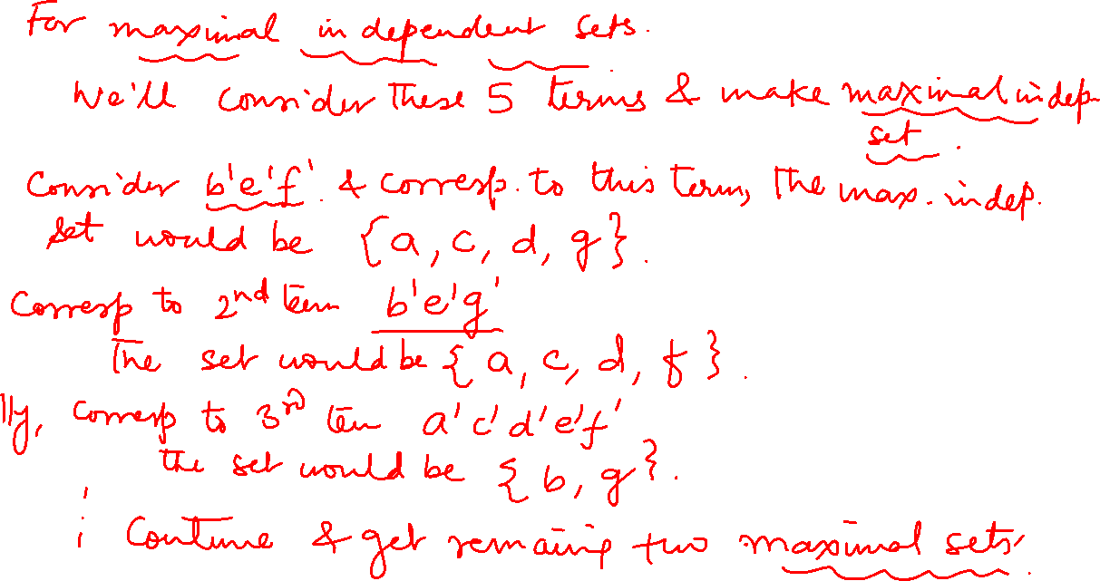

Slide 11
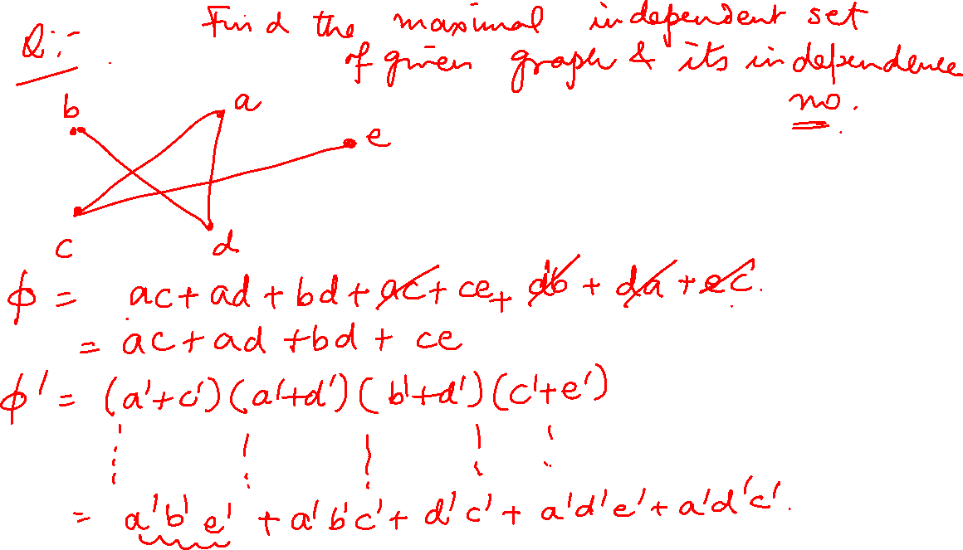

Slide 12
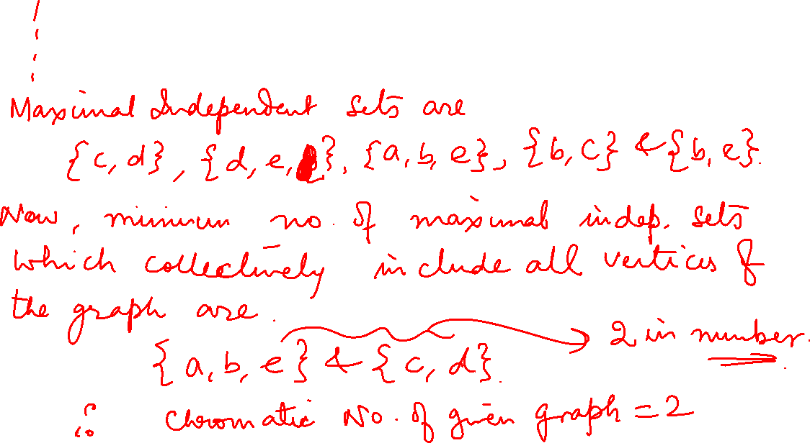

Slide 13
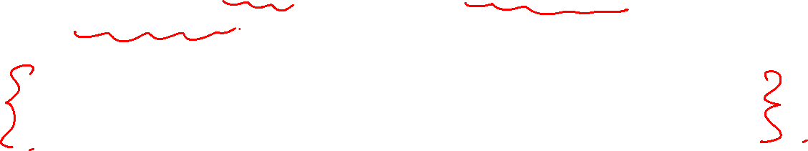
Graph Theory and its Applications Independence Number and Chromatic Number
Maximal Independent set with the maximum number of vertices is called the independence number.
Minimum number of maximal independent sets which collectively include all the vertices of G determines the chromatic number of the graph.
Independence number of graph G is 4
(a,c,d,f), (b,g),(a,e) satisfy this property. Hence the Graph is 3-chromatic.

Slide 14

Graph Theory and its Applications Chromatic Partitioning
Given a simple, connected graph G, partition all vertices of G into the smallest possible number of disjoint, independent sets. This is known as the chromatic partitioning of graphs, (one of the most important problem in partitioning of graphs.)
The following 4 are some Chromatic
Partitions
{(a, c, d, f), (b, g), (e)},
{(a, c, d, g), (b, f), (e)},
{(c, d, f), (b, g), (a, e)},
{(c, d, g), (b, f), (a, e)}

Slide 15
Graph Theory and its Applications Graph Coloring
Find the maximal independent set of graph G. Find its independence number and chromaticity.
a
b
c
d
e

Slide 16
Graph Theory and its Applications Graph Coloring
Find the maximal independent set of graph G. Find its independence number and chromaticity.
a
b
e
c
d

Slide 17



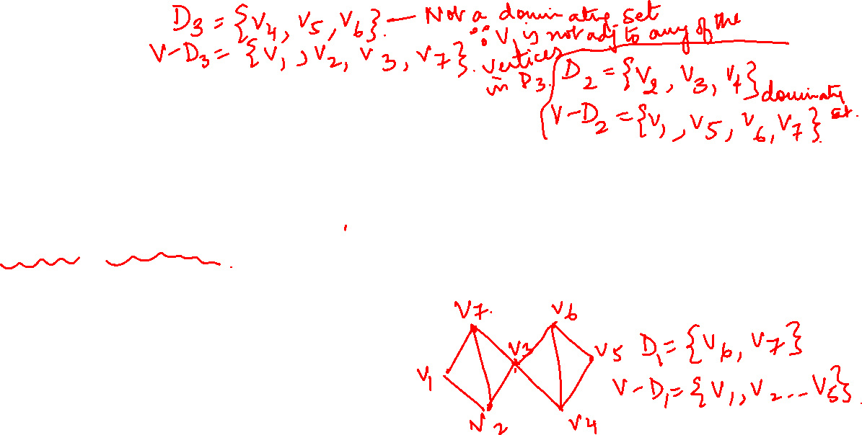






Graph Theory and its Applications Graph Coloring
Internally stable set: Maximal Independent set
Externally stable set: Dominating set
Dominating Set:
A dominating set or an externally stable set in a graph G is a set of vertices that dominates every vertex v in G. Either v is included in the dominating set or is adjacent to one or more vertices included in the dominating set.
A minimal dominating set is a dominating set from which no vertex can be removed without destroying its dominance property.
The # of vertices in the smallest minimal dominating set of a graph G is called the domination number α(G)

Slide 18
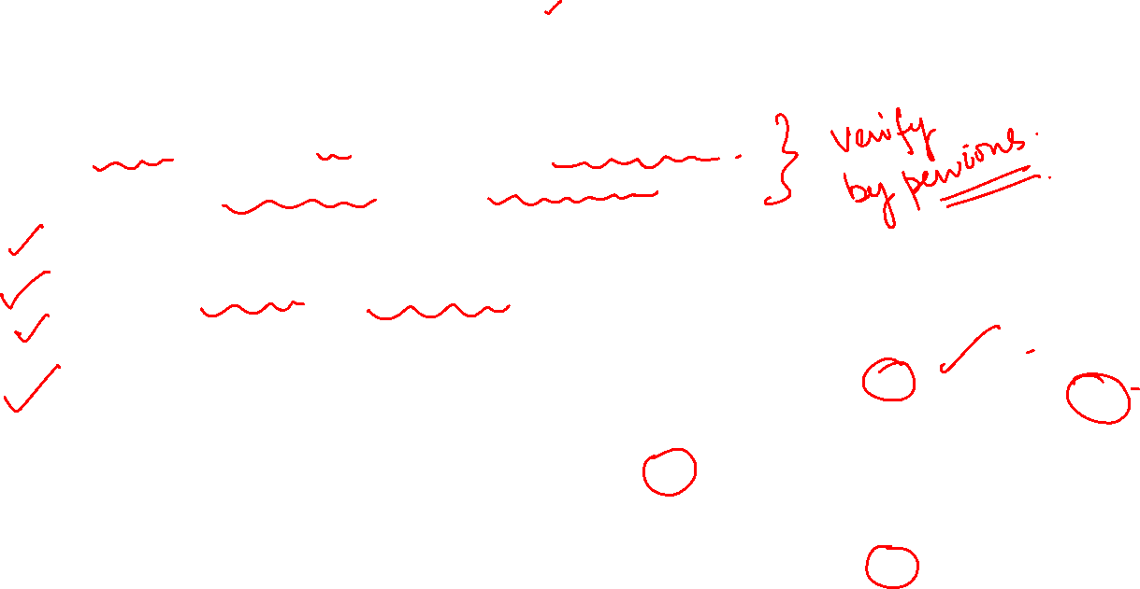
Graph Theory and its Applications Graph Coloring
Internally stable set: Maximal Independent set
Externally stable set: Dominating set
Dominating Set:
A minimal dominating set may or may not be independent.
Every maximal independent set is a dominating set.
(bg)
(abcdf)is not minimal and not independent (acdf) is minimal
(be) is minimal but not independent

Slide 19
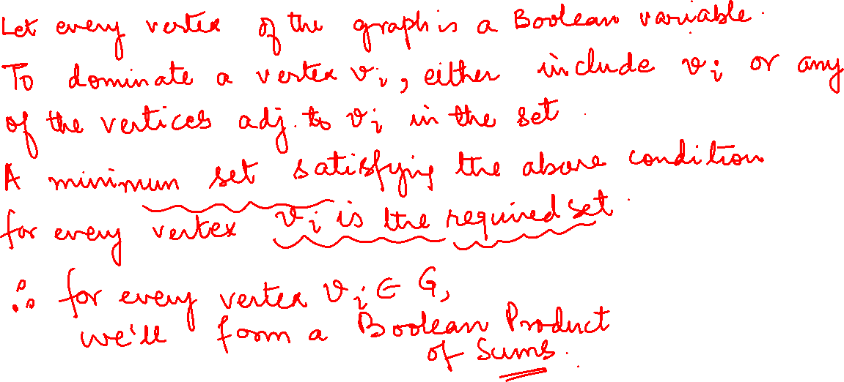
Graph Theory and its Applications Graph Coloring
Finding Minimal Dominating sets( Using Boolean Arithmetic )

Slide 20
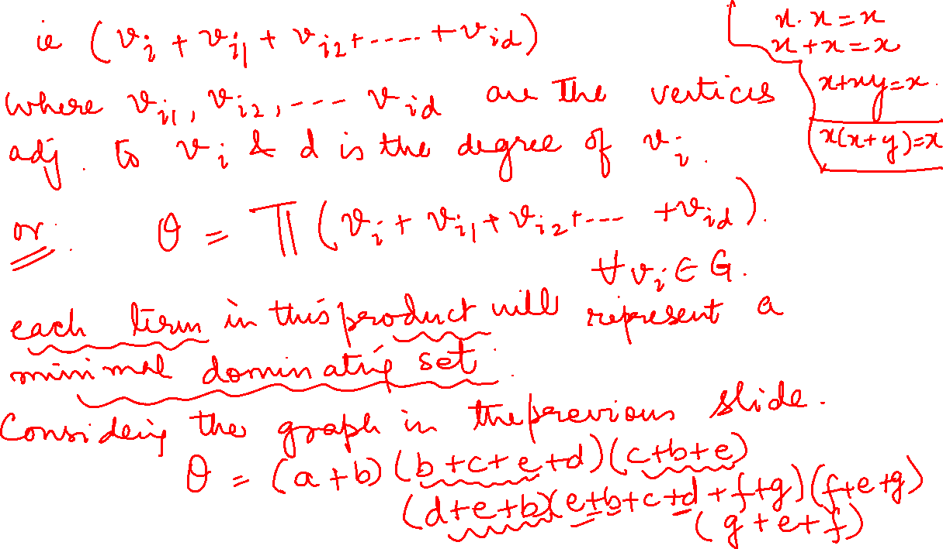
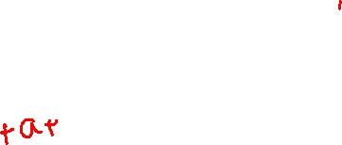

Slide 21
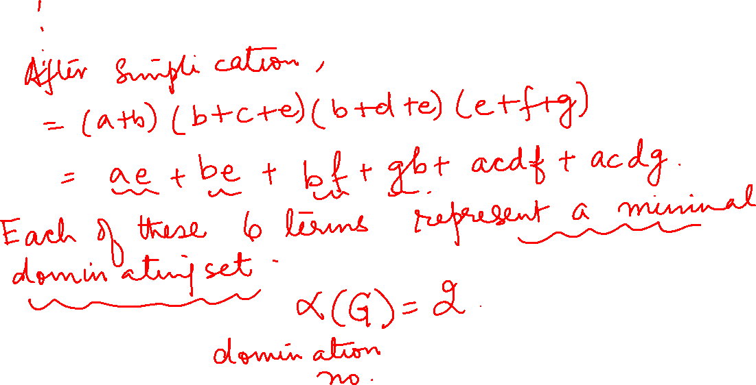

Slide 22
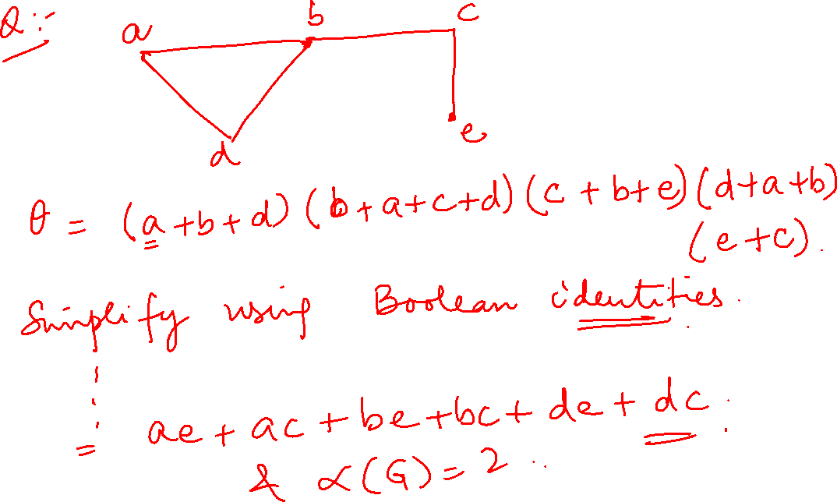

Slide 23
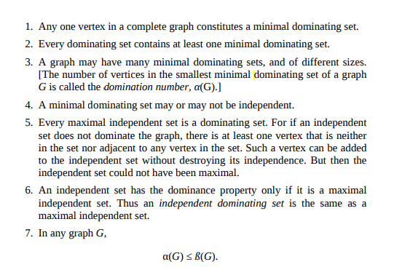
Graph Theory and its Applications Some Observations from definitions

Slide 24
Graph Theory and its Applications Graph Coloring
Find the minimal dominating set of graph G. Find its dominance number.
a
b
c
d
e

Slide 25
THANK YOU
Dr. Arti Arya
Department of Computer Science &Engineering
artiarya@pes.edu

